Slide 1
Authentic Execution in Smart Farming
Student: Gianluca Scopelliti
Supervisors: Frank Piessens, Jan Tobias Mühlberg, Fritz Alder

Slide 2
Smart Farming

Slide 3
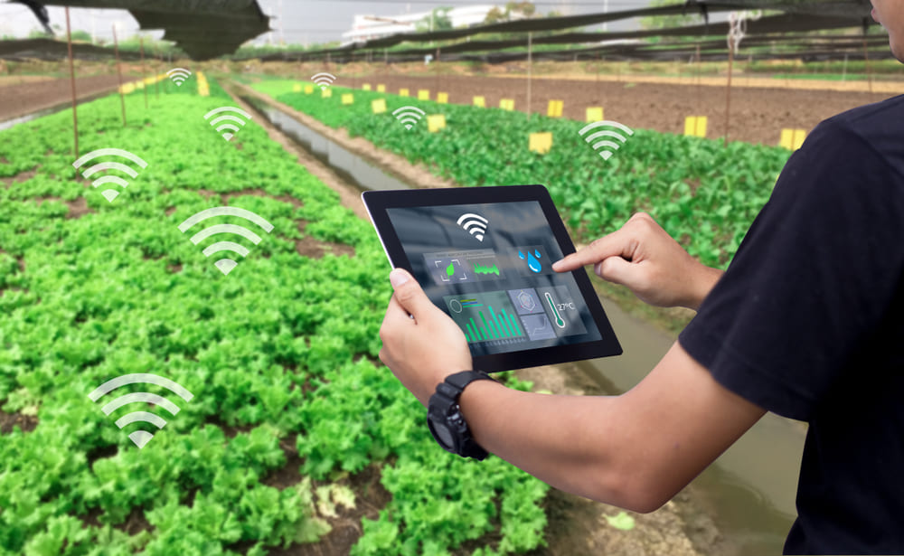
What is Smart Farming?
Application of modern ICT in agriculture
Embedded devices connected to:
Sensors, to collect data from the physical world (e.g. temperature, humidity, light…)
Actuators, to perform operations to the physical world (e.g. irrigation, animal feeding…)
Central servers to store data and execute software for computing statistics and/or predictions

Slide 4
Why?
In general, the goal is to maximize profits and minimize costs
The data collected is processed by servers using specialized software, providing to the farmer statistics and support for decisions
Typically, the farmer interacts with the system through a dashboard
The main benefits of using this approach are:
Improve input efficiency, by applying the optimal amount of nutrients, seed or chemical products such as pesticides at the right location and time, using the right type of product
Identify anomalies such as diseases, by analyzing the general health of the crop and livestock
Reduce labor time and costs, by using actuators and specialized software for performing operations with limited human intervention

Slide 5
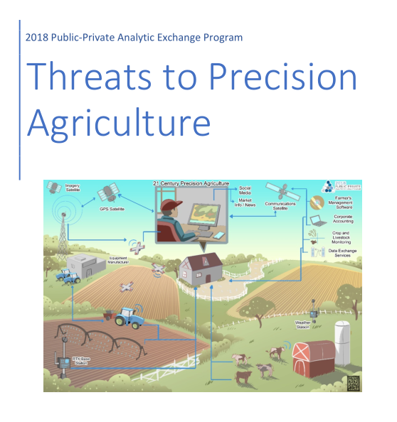
Threats to Precision Agriculture
Paper released by US Department of Homeland Security (DHS) in 2018
“[…] addresses the security threats related to the adoption and impact of new digital technologies in crop and livestock production.”

Slide 6
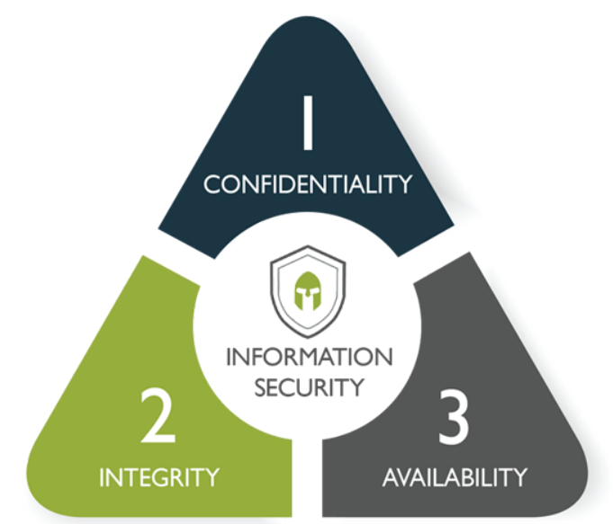
Security issues
Confidentiality
Theft of data
Leak of data
Foreign access to data
Integrity
Manipulation of data
Introduction of fake data
Manipulation of actuators
Availability
Block / alter nodes
Block / alter communication between nodes

Slide 7
Trusted Computing and Authentic Execution

Slide 8
Trusted Computing
Technology developed by the Trusted Computing Group
Goal: provide strong guarantees that a software will not misbehave
Even in a system where all the other components (OS, other SW) are untrusted!
Key concepts:
Endorsment Key: unique private key that never leaves the hardware
Memory curtaining: isolation of sensitive areas of memory
Sealed storage: bind data to a specific device or software
Remote attestation: authenticate hw / sw configuration to a remote host
Trusted third party: an intermediary to provide (ano|pseudo)nymity
In practice we have many different architectures which implement a subset of these features, and they also provide new features such as Enclaved execution and secure I/O

Slide 9
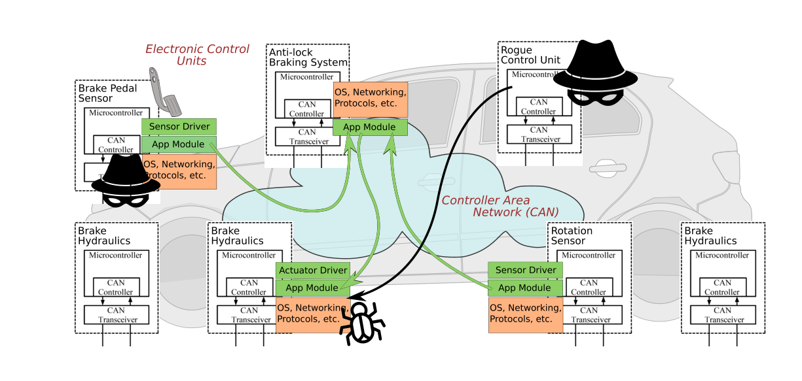
VulCAN
An application of Trusted Computing in the automotive context
Force points:
Message authentication
Software component attestation and isolation

Slide 10


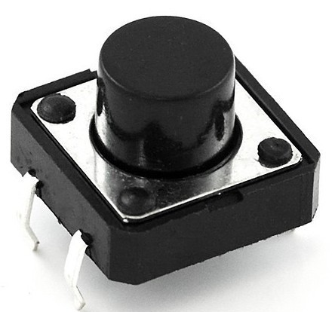

Authentic Execution
«if the application produces a physical output event (e.g.,
turns on an LED), then there must have happened a sequence of physical input
events such that that sequence, when processed by the application (as specified
in the high-level source code), produces that output event. »
Connection
OUTPUT:
buttonPressed()
INPUT:
incrementCounter()
SM 1
SM 2
Event Manager
(UNTRUSTED!)

Slide 11
Limitations of the current implementations
VulCAN handles a specific communication medium (CAN)
The code is then adapted for dealing with its characteristics
Broadcast network
64-bit packets (-> MAC truncation)
…
The current implementation of Authentic Execution manages only Sancus devices
What about different architectures like SGX?

Slide 12
My Master’s Thesis

Slide 13
My Master’s Thesis work
Generalize the concept of Authentic Execution
Communication medium: provide a sort of generic API which abstracts the network layer
Goal: the code written by the developer should be transparent to the communication medium used
The developer has only to specify the technology used and its parameters in a configuration file
Different architectures: provide support for another architecture (Intel SGX)
Goal: we want to simulate a system composed by heterogeneous components (from lightweight IoT devices to desktop/server architectures)
Many real scenarios present such situation (e.g. Smart Farming)

Slide 14
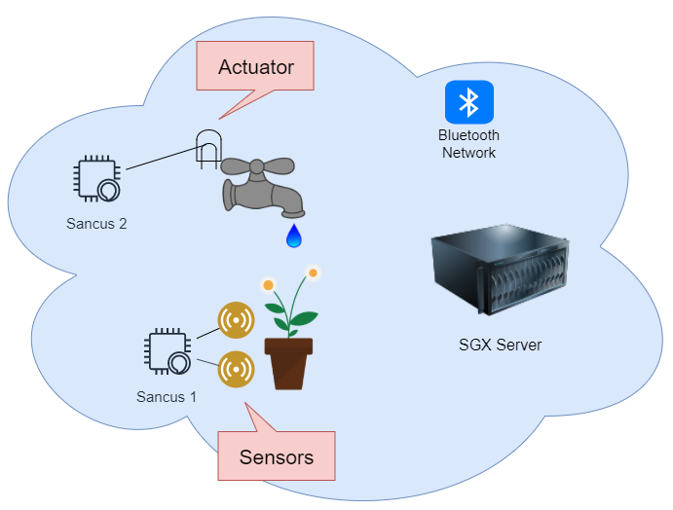
A prototype: Authentic Execution for automatic irrigation
Goal: apply the concepts described in the previous slide to a concrete use case in the context of Smart Farming

Slide 15
Schedule
Within the holidays: completing the reading / planning phase
From January onwards: implementation phase
Authentic execution between two SGX enclaves
Authentic execution in a heterogeneous system (SGX + Sancus)
Generic API for the communication

Slide 16
Conclusions

Slide 17
Conclusions
Goal: Create a system which provides strong security properties in presence of malicious actors
Confidentiality, integrity features
Application in a specific context (smart farming)..
.. but can be also applied to any other areas with different:
Architectures
Communication mediums

Slide 18
References
Threats to Precision Agriculture
Tutorial dsn18 slides
Article about Smart Farming
VulCAN
Authentic Execution
Image slide 3
Image slide 6

